Slide 1
Strengthening Cyber Security Against External Threats in Connected Aviation Systems
Securing every connection. Protecting every flight. Sustaining every trust.

Slide 2
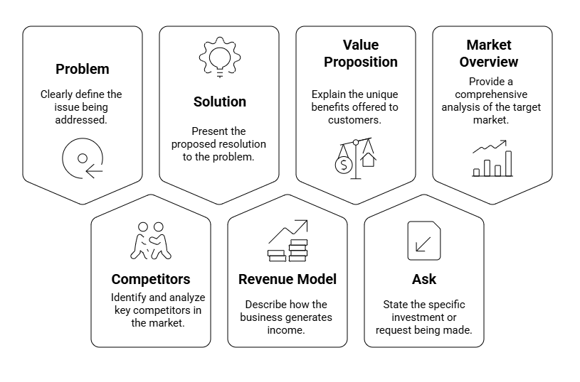
Our Agenda

Slide 3
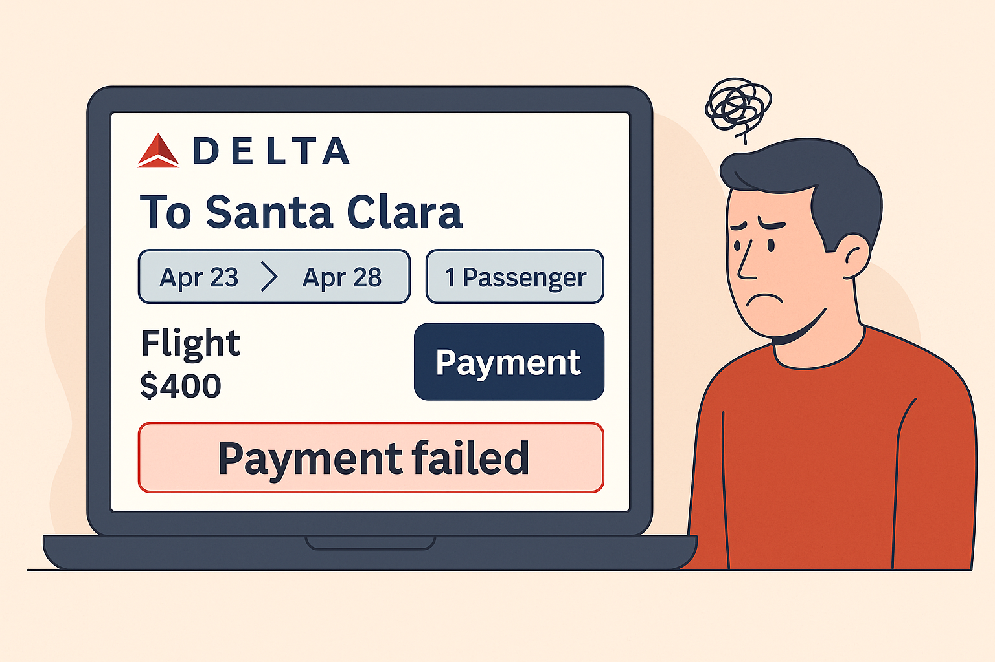
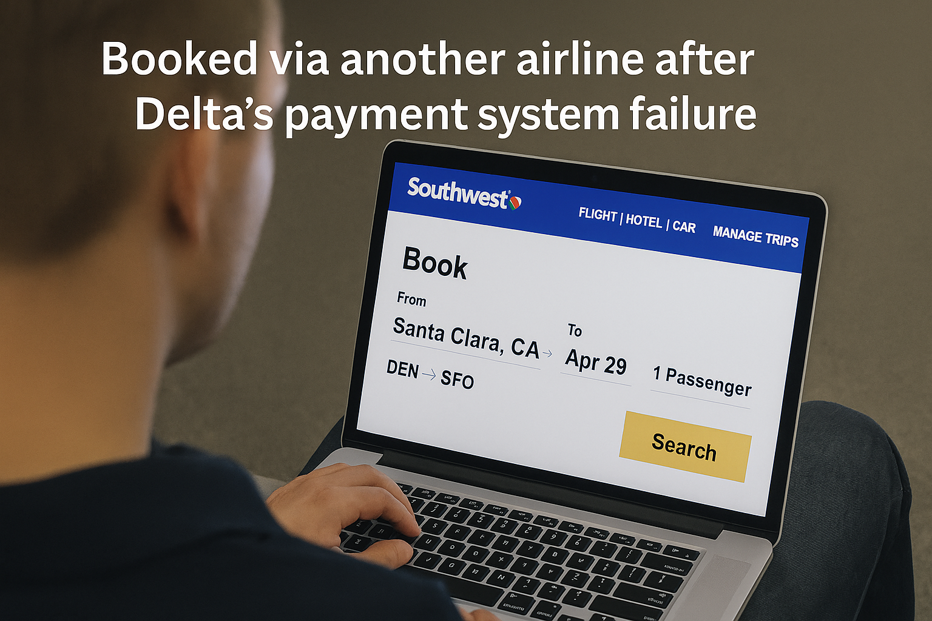
A $400 Booking Lost in Seconds And Trust Along With It

Slide 4


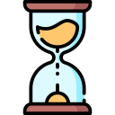
What 10 Minutes of Silence Really Costs?
$1M Revenue & Trust Lost
10,000 Bookings Lost
10 Min Downtime

Slide 5
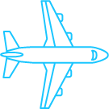

Insights from Customer Discovery
Lawrence Mwenda, Revenue Management, Air France–KLM
“Third-party sync problems result in booking mistakes; strengthening audit logs, encryption, and access limits became necessary.”
Kalea Teixeira, FAA Policy & Operations:
“Third-party platform risks now carry both regulatory and continuity consequences.”
Dr. Maureen McWhite, Cybersecurity Professor
“Weak links are very perilous to business continuity and they demand audit-grade visibility and resilience.”
Jeff H., Ex-Principal Consultant & Aerospace Lead, NCC Group
“Third-party systems introduce technical, security, and governance challenges, untrusted data flows break integrations and trust”
Final Refined Problem Statement
Airlines face growing business risk from insecure third-party integrations protecting these digital connections is essential to maintain trust and continuity.

Slide 6
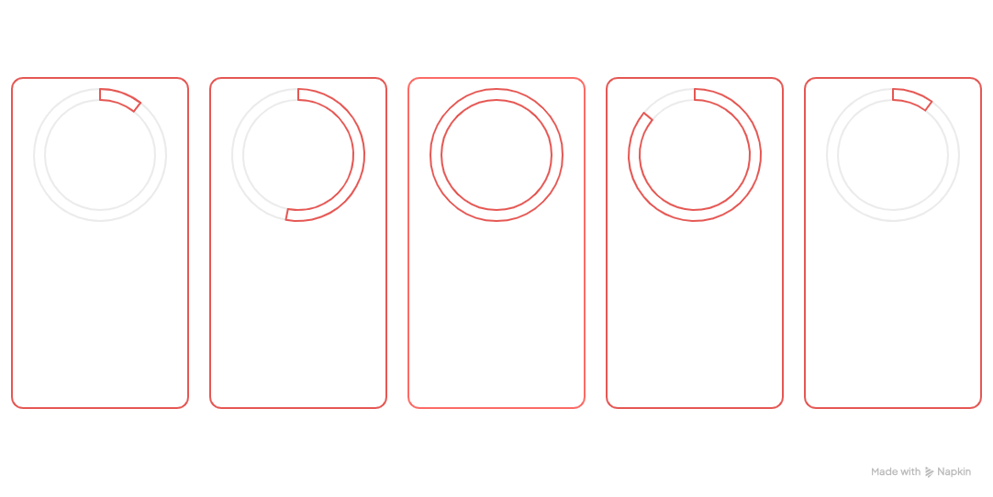
10.5 M
53%
160$
86%
10 M
Average US Breach Cost
Breaches involve Customer PII loss
Customer PII loss per record
Breaches cause operational disruption
Average regulatory fines per breach
Breaches are expensive, averaging $10.5M.
Each lost customer record costs $160.
Breaches cause significant operational disruption.
Breaches often involve customer data loss.
Regulatory fines average $10M per breach.
Third-party/API attacks are costly, causing significant financial, operational, and reputational damage.

Slide 7
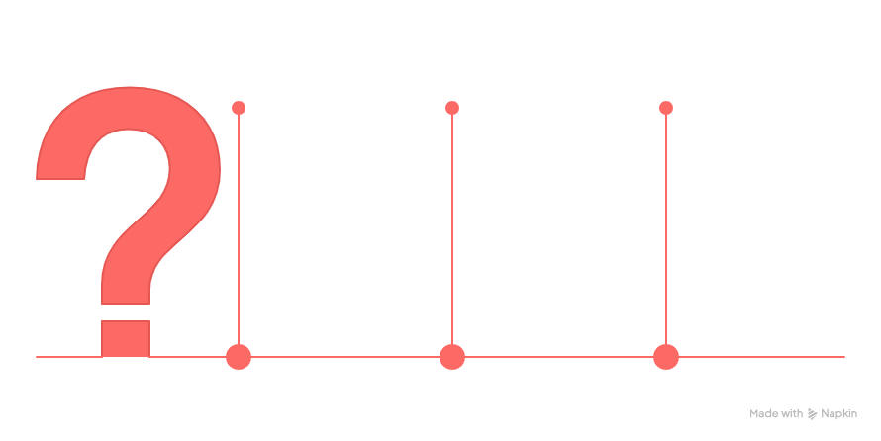
Our Purpose: Why We Exist?
Ensure Resilience
Secure connections provide resilience against disruptions, ensuring continuity of operations.
Build Confidence
Secure connections build confidence among stakeholders, enhancing overall industry stability.
Maintain Trust
Securing connections ensures trust in the aviation industry, which is crucial for reputation and financial stability.

Slide 8
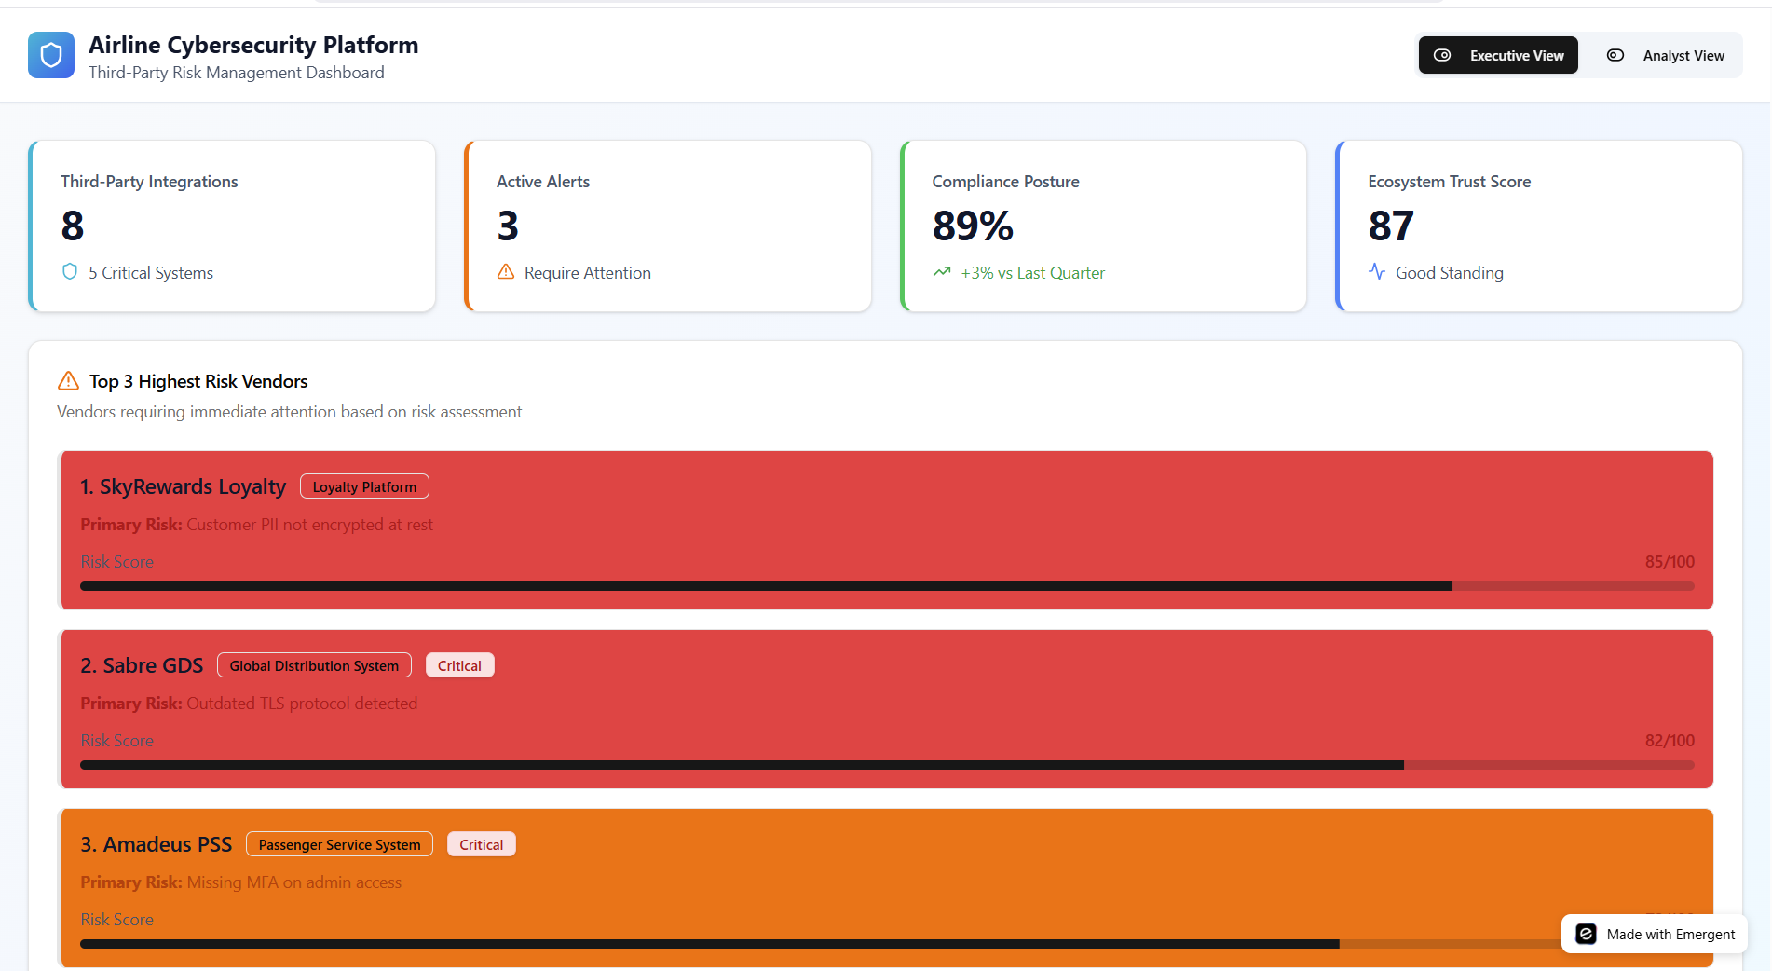

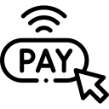







AEROSEC - Real-time Vendor Cyber Risk Dashboard
WHY?

Slide 9
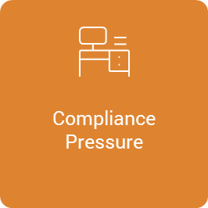
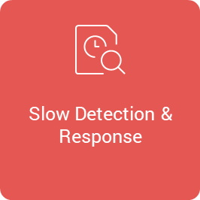

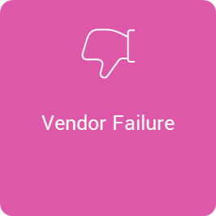
WHY DO AIRLINES NEED AEROSEC?
WHY?

Slide 10
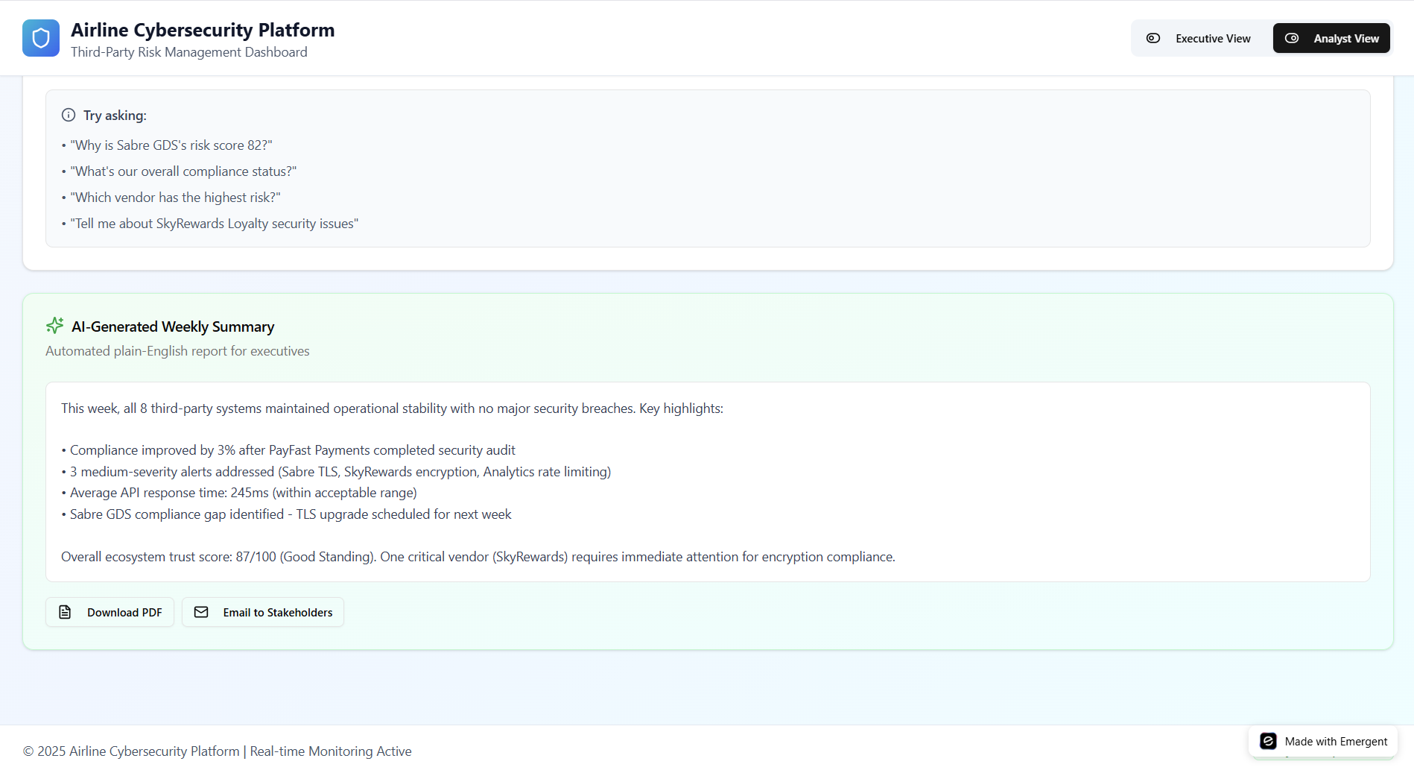
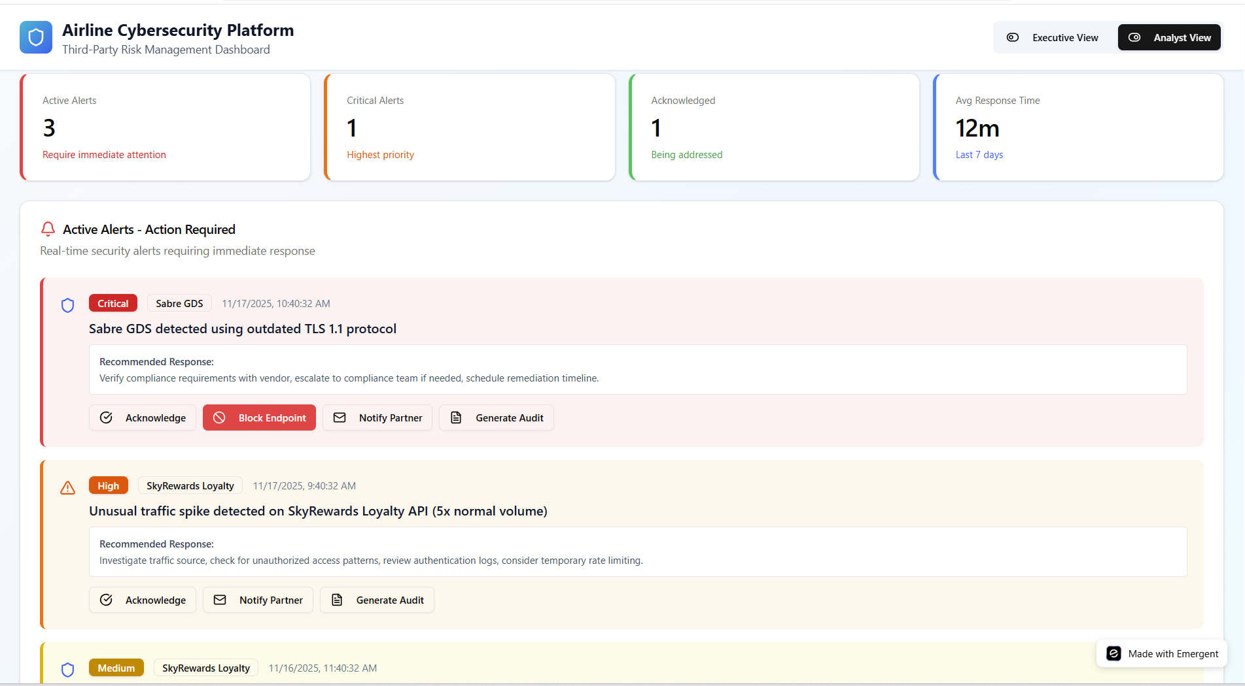
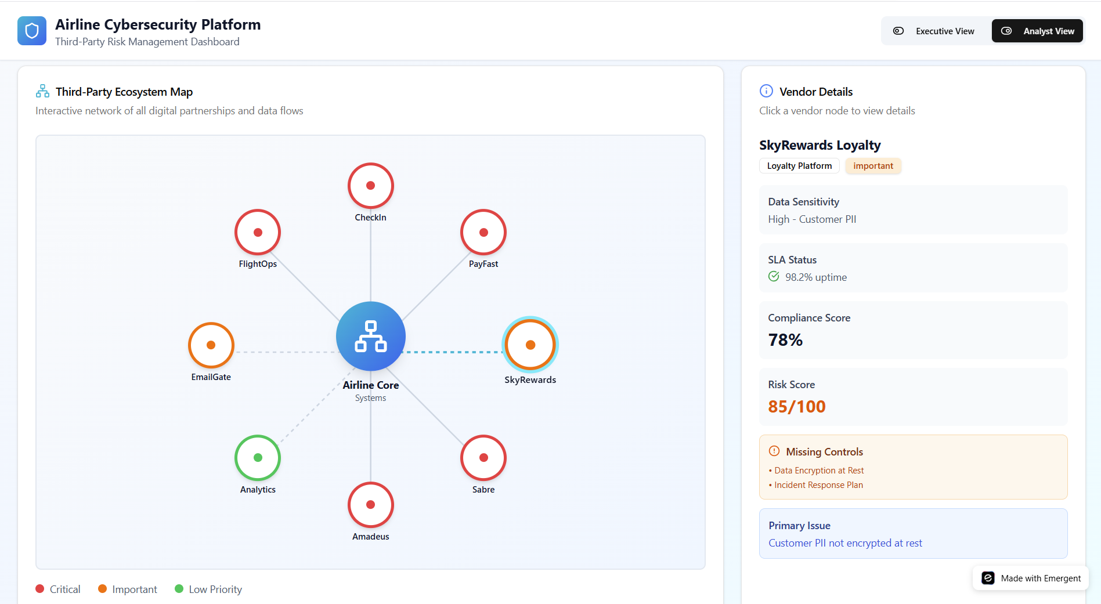
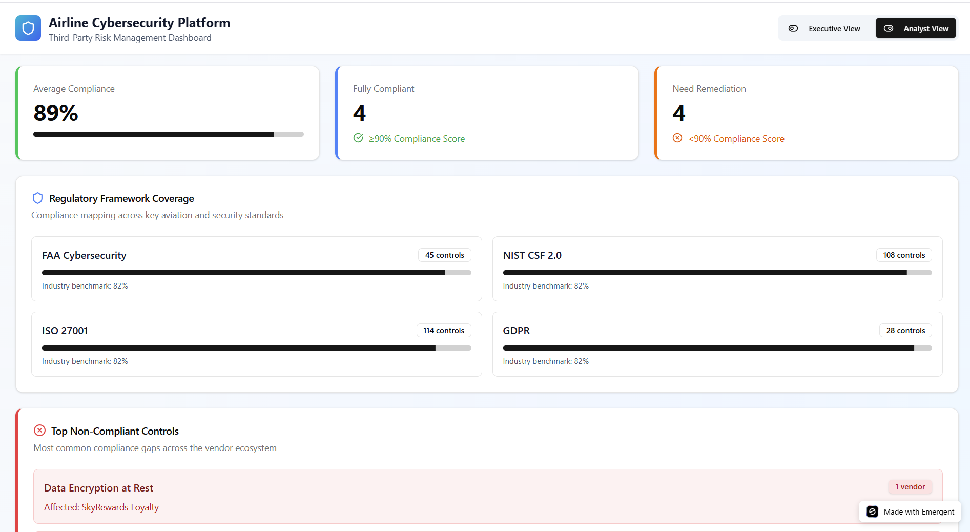
AEROSEC Dashboard: From Risk to Resilience
Ecosystem Map
Compliance Hub
Live Risk Monitor
Analytics & Insights
Visibility Engine
70% faster issue detection
Live map of vendor connections & trust scores.
Compliance Hub
80% faster audit turnaround
One-click audit logs aligned with FAA & ISO.
Live Risk Blocking
$1.2M downtime cost prevented
Detects & blocks risky vendor activity in real time.

Slide 11

Value Proposition
Before: Aerosec | After: Aerosec
Failed Connections 15–20% of transactions silently fail | Secure Connections 24/7 API risk monitoring
Revenue Loss Up to $450K/hour lost during disruptions | Prevented Revenue Loss Fewer failed checkouts = sales kept, not lost.
Paying fines $10M+ per Breach | No More Fines $10M+ saved in compliance effort
Unhappy Customers Customers give up when bookings fail | Happy Customers Seamless booking keeps customers.

Slide 12
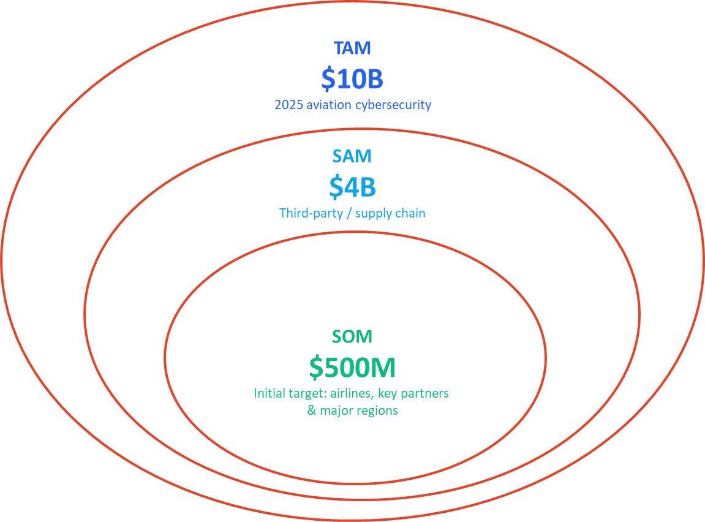
Market Size (TAM / SAM / SOM)
Aviation cybersecurity market (Global aviation cybersecurity)
Third-party/supply chain segment (~40% of aviation cyber budgets now redirected to secure data exchanges, PSS, and cloud partner ecosystem)
Target airlines & Vendors - Targeting Major and Mid-Size Airlines - Regions with Highest Incident Rates, UK & US Airlines

Slide 13


Competitors
Solution | Aviation Focus | Third-Party API Protection | Airline-System Integration | Compliance Support | Easy Response Workflows
AeroSec
Salt Security
Cloudflare
Imperva
Traceable AI

Slide 14
HOW WE MAKE MONEY ?
Feature
Monthly Cost
Yearly Cost
Integrations
Support
Additional Features
Starter Plan
Standard support
Audit reports
$2,000/mo
$20,000/yr
Up to 5
Priority support
Pro Plan
$4,000/mo
$40,000/yr
20
Live alerts
Enterprise Plan
$8,000/mo
$90,000/yr
50+
24/7 support
Full compliance suite

Slide 15
Go-to-Market Roadmap
Integration Testing Phase
Beta Testing & Final Launch Prep
Development, Quality Assurance (QA)
Initial beta testing with 1–2 clients, Acquire first 5–10 paying clients
1
3
Months 1–3
Months 4–6
Months 7–9
Months 10–12
MVP/Prototype Development
2
Marketing & Sales Preparation
4
Ideation, Concept Development, Prototyping
Market Strategy, Pre-Launch Marketing

Slide 16
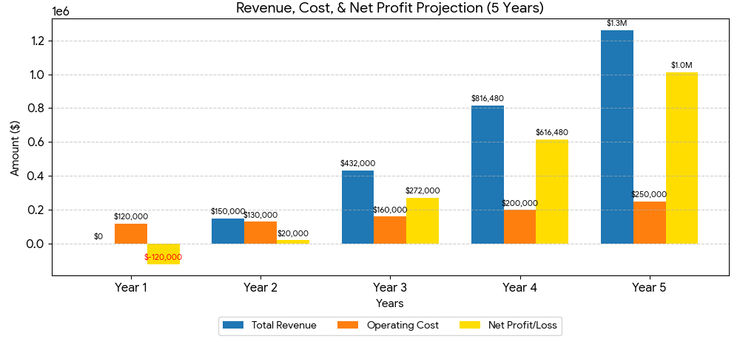
Revenue & Net Profit Projection (5 Years)

Slide 17
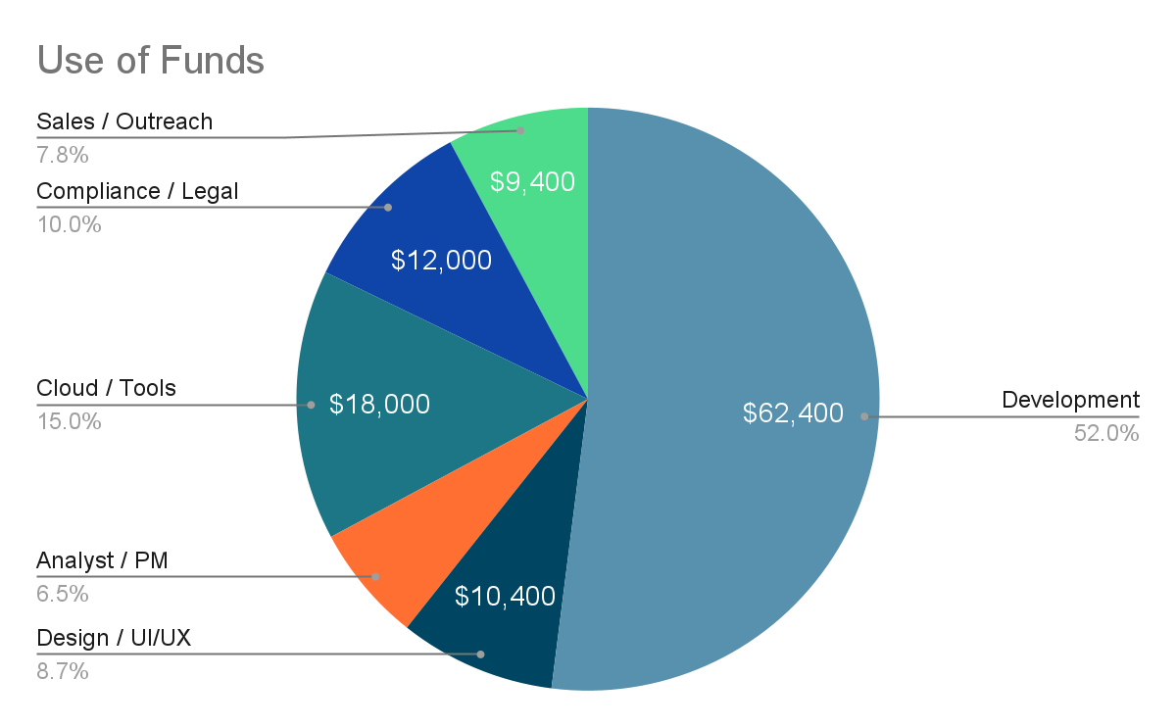
Use of Funds
Cost Structure
$120,000

Slide 18





Team Roles
Harshith Manne
Product & Prototype Lead
Pooja Kiran
Business & compliance Lead
Michael Whang
Strategy Advisor
Kumkum
Technical Insights Lead
Sai Ram
Market Research Lead

Slide 19

Trust in Motion - Powering Aviation with Secured Connections
“In aviation, every digital handshake is a promise of trust
and AEROSEC ensures that promise is never broken.”

Slide 20
THANK YOU!

Slide 21
BACKUP SLIDES

Slide 22




Booking Systems
Cleaner / Housekeeper
Electrician
Payment Processors
Plumber
Loyalty Programs
“One weak third-party = big security breach.”
Security Guard / Doorkeeper
Third Party Vendors

Slide 23
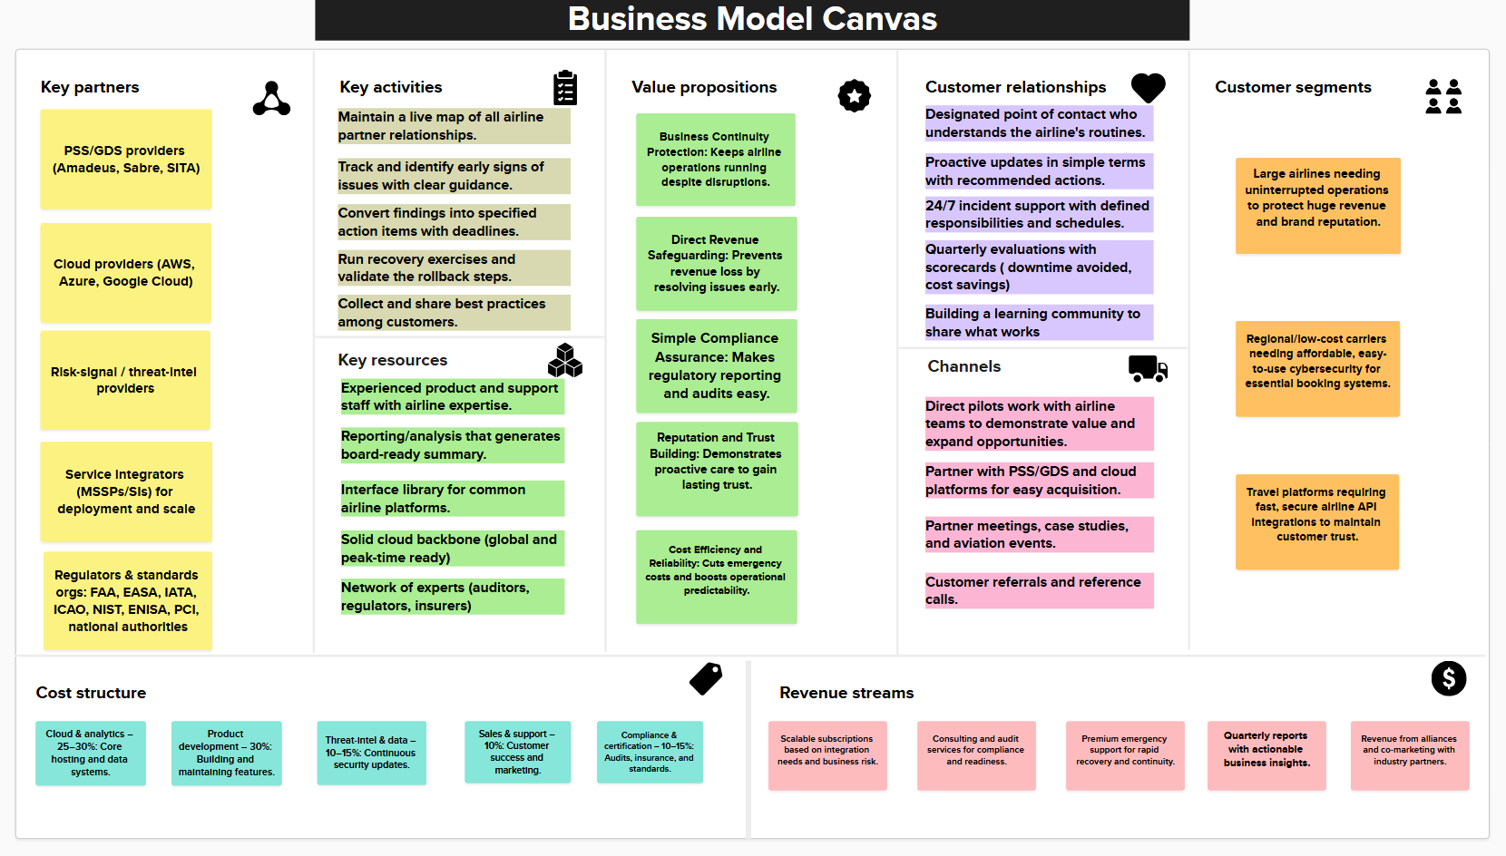
Business Model Canvas - Backup Slide

Slide 24
Use of Funds (Aligned with Year 1 Costs)
Fund Allocation | Amount Requested | Purpose / Details
Development | $62,400 | Developer: 20 hrs/week × 52 wks × $60/hr
Design / UI/UX | $10,400 | Designer: 4 hrs/week × 52 wks × $50/hr
Analyst / PM | $7,800 | Analyst / Project Manager: 3 hrs/week × 52 wks × $50/hr
Cloud / Tools | $18,000 | AWS/Azure, logging, CI/CD, monitoring
Compliance / Legal | $12,000 | Privacy, contracts, filings
Sales / Outreach | $9,400 | Website, demo tools, CRM
TOTAL Funding Requested | $120,000 | Fully covers Year 1 operating costs

Slide 25
Funding Requirement & Runway
Metric | Amount / Period | Assumptions / Notes
Total Funds Requested | $120,000 | Covers Year 1 operating costs
Monthly Burn Rate | $10,000 | $120,000 ÷ 12 months
Projected Runway | 12 months | Funds last until revenue starts covering costs
Revenue Start / Cash Inflow | Month 3 | Assumes first clients start paying by Month 3
Break-even Point | Month 9–10 | When cumulative revenue ≥ cumulative costs

Slide 26
Operating Cost Breakdown (Year 1)
Cost Category | Calculation / Basis (Realistic) | Estimated Cost (Target: $120K)
Developer | 20 hrs/week × 52 wks × $60/hr | $62,400
Designer | 4 hrs/week × 52 wks × $50/hr | $10,400
Analyst/PM | 3 hrs/week × 52 wks × $50/hr | $7,800
Cloud/tools | AWS/Azure + logging + CI/CD + monitoring | $18,000
Compliance/legal | Privacy, contracts, filings | $12,000
Sales/outreach | Website, demo tools, CRM | $9,400
TOTAL ANNUAL COST | — | $120,000

Slide 27
Forecasting Our Fifth-Year Target: The Strategic Path to $755,820
Enterprise Clients
4
Annual Plan @ $60K
$240K
Yearly @ $40K
8
$320K
$755,820
(Annual Gross Revenue)
Mid-size Airlines
12
Monthly @ $25K
4
$100K
Platform Partners
Starter Plan @$23,955
4
$95,820

Slide 28
Revenue & Net Profit Projection (5 Years)
Metric | Year 1 | Year 2 | Year 3 | Year 4 | Year 5 | Calculation / Notes
Clients | 0 | 3 | 8 | 14 | 20
Price / Client | -- | $50,000 | $54,000 | $58,320 | $62,986 | 8% Annual Price Increase (from Year 3 onward).
Revenue | 0 | $150,000 | $432,000 | $816,480 | $1,259,712 | Formula: (Clients)×(Price per Client)
Operating Cost | $120,000 | $130,000 | $160,000 | $200,000 | $250,000
Net Profit / Loss | -$120,000 | $20,000 | $272,000 | $616,480 | $1,009,712 | Formula: (Revenue)−(Operating Cost).
Margin % | -- | 14% | 63% | 76% | 81% | Rounded Up to the nearest whole percentage.

